Slide 1
User Guide
Candidate Screening System

Slide 2
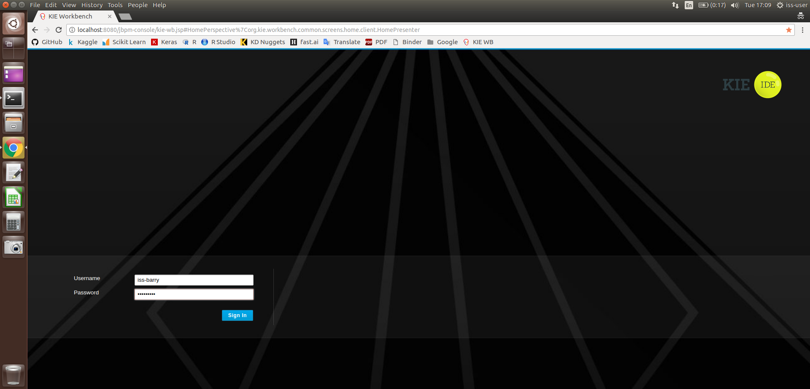
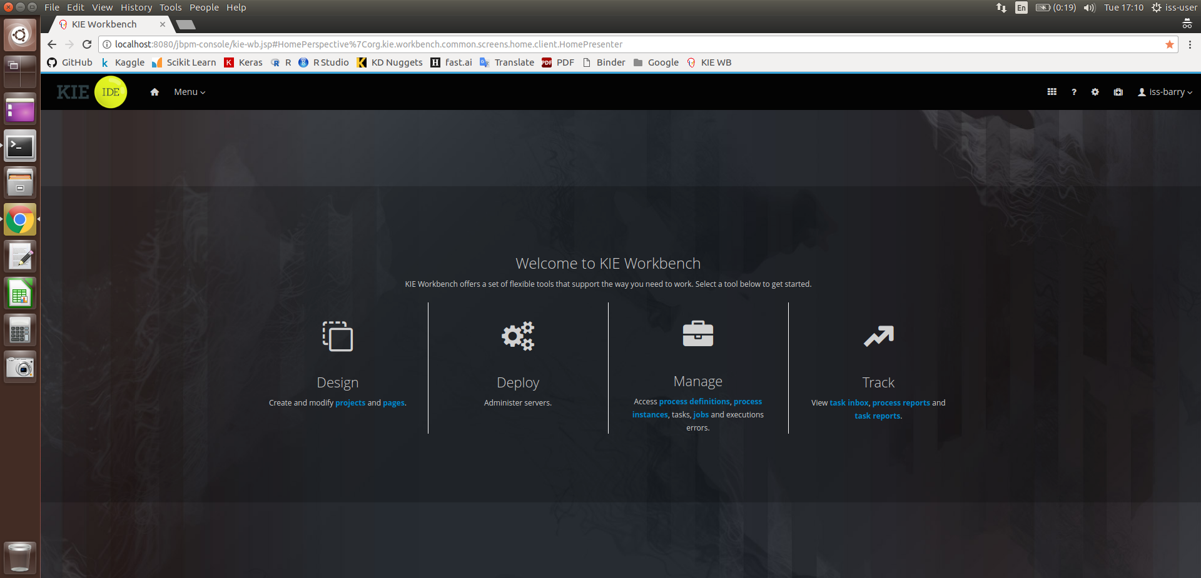
User Guide
Log in as iss-barry.
On the menu page, select Manage and go to Process Instance.
Candidate Screening System

Slide 3
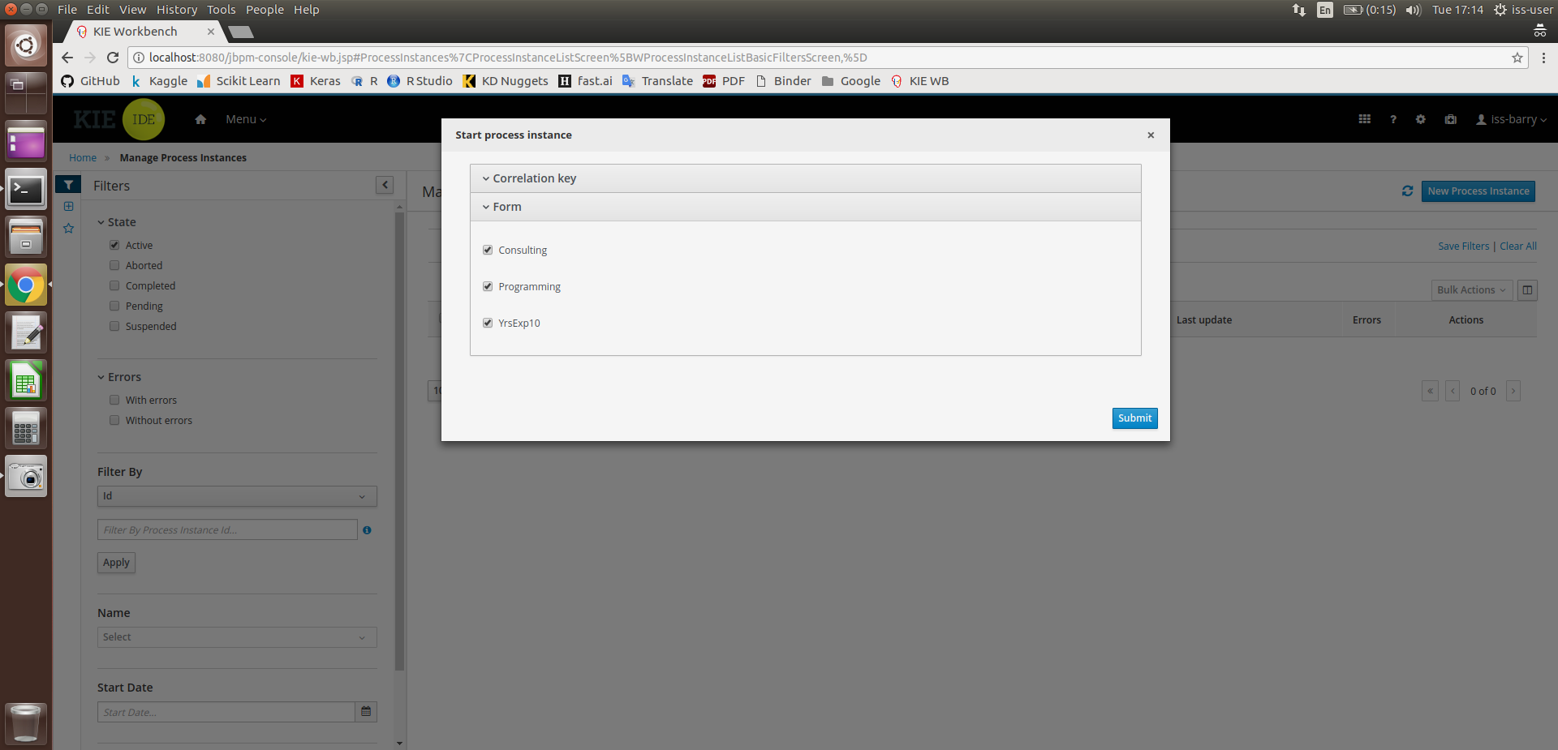
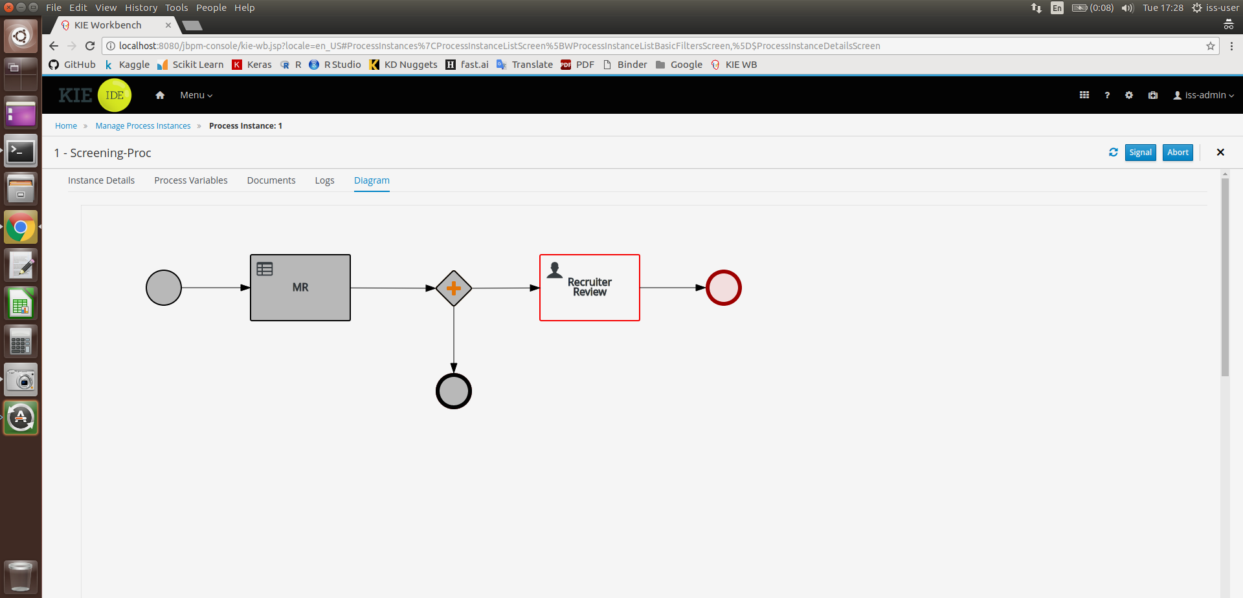
User Guide
Tick appropriate Check Boxes as input.
Next, the workflow will be pending the Recruiter’s review.
Candidate Screening System

Slide 4
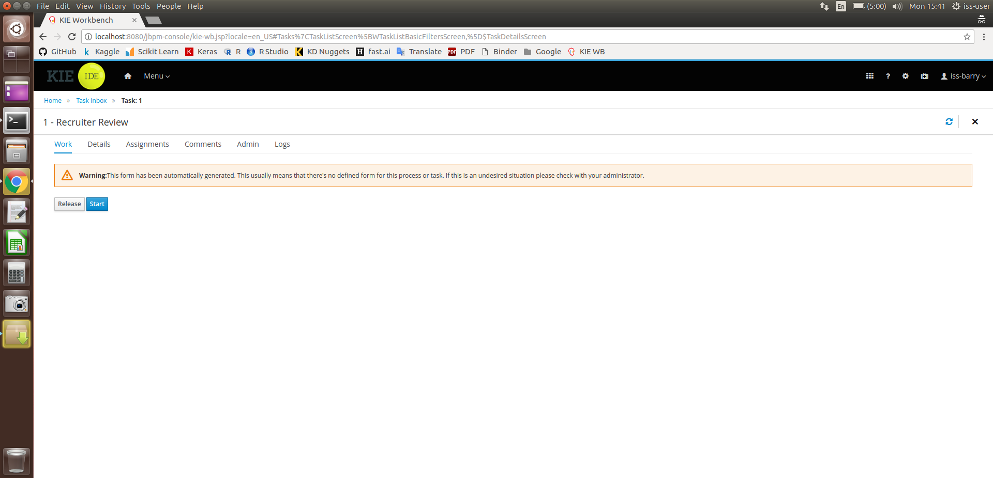
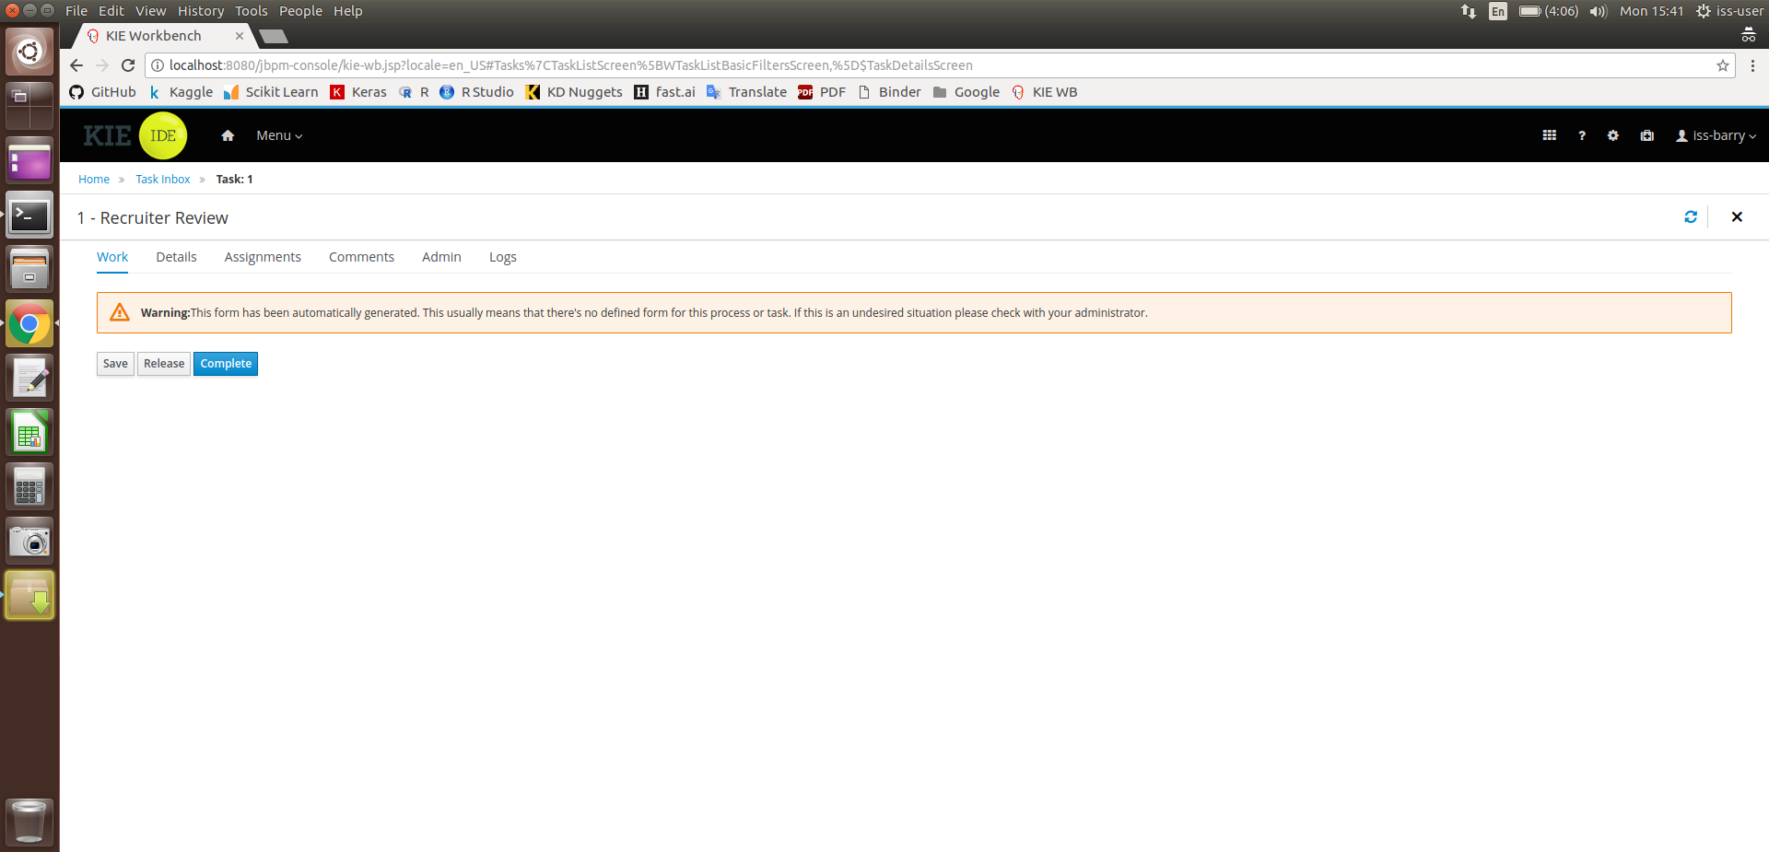
User Guide
Click on Start.
And then Complete.
Candidate Screening System

